Slide 1
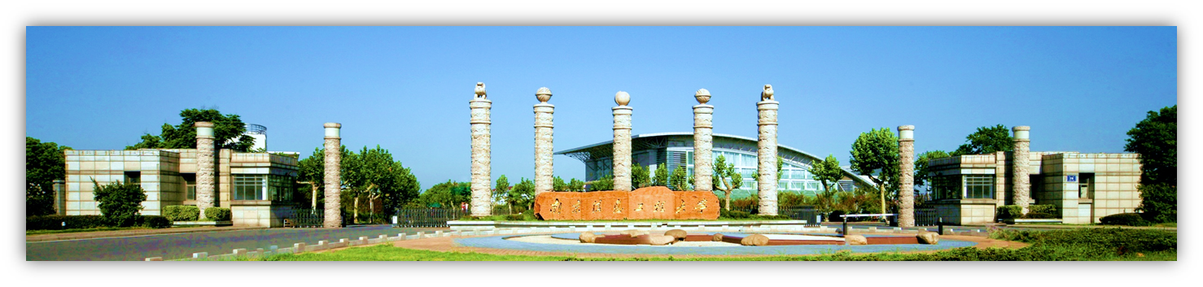
Chapter 4 Continuous-Wave Modulation (连续波调制)
Linear modulation: 线性调制
Amplitude modulation (AM) 调幅
Double-sideband modulation (DSB) 双边带调制
Single-sideband modulation (SSB) 单边带调制
Vestigital-sideband modulation(VSB)

Slide 2
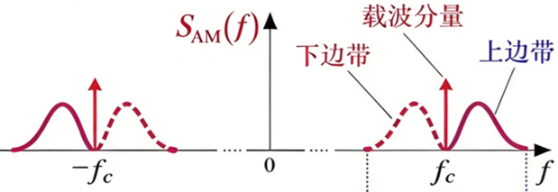
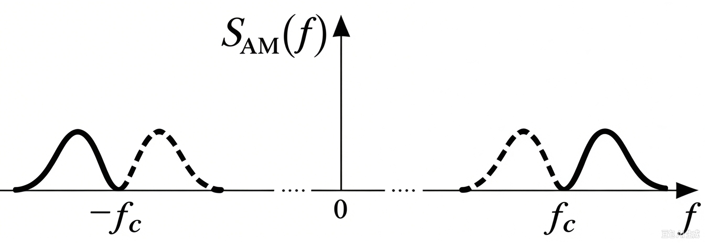
DSB modulation system
USB: upper side band
LSB: lower side band
Improve the power efficiency
SDSB(f)
USB LSB
LSB USB
DSB removes the carrier of AM to improve power efficiency, keeping both sidebands.

Slide 3
DSB modulation system
System model: abstraction
系统模型：抽象
Time & frequency-domain characteristics
时域频域特性
Anti-noise performance 抗噪声性能
Practical DSB modulation 实际 DSB 系统
Special Topic: I/Q Paths I/Q支路专题

Slide 4
Mathematical model
sm(t)
m(t)
Channel
BPF
带通滤波
LPF
低通滤波
~
×
×
m(t)
cosωct
carrier
cosωct
n(t)
加性噪声
Modulation
m(t): baseband message signal; also called modulating signal;
the original low-frequency audio signal to be transmitted.
cosωct : carrier; high-frequency sinusoidal carrier wave;
sm(t): DSB modulated signal；
the high-frequency DSB signal after modulation.

Slide 5
Mathematical model and Definition
m(t)
sm(t)
BPF
带通滤波
LPF
低通滤波
~
Channel
×
m(t)
×
cosωct
carrier
cosωct
n(t)
加性噪声
Coherent demodulation
相干解调
~
m(t): recovered baseband signal.
Coherent Demodulation (Synchronous Demodulation) Demodulate with a local carrier synchronized in frequency and phase to the transmitted carrier.
使用与发送载波同频同相的本地载波进行解调。
Key: No threshold effect.
无门限效应。

Slide 6
Mathematical model and Definition
m(t)
sm(t)
BPF
带通滤波
LPF
低通滤波
~
×
Channel
×
m(t)
cosωct
carrier
cosωct
n(t)
加性噪声
coherent carrier
相干载波
Tx-Rx synchronization
收发同步
Classic coherent carrier extraction methods:
--Pilot tone insertion 导频插入法
--Squaring loop 平方环法
--Costas loop 科斯塔斯环法
--M-th power loop M 次方环法

Slide 7
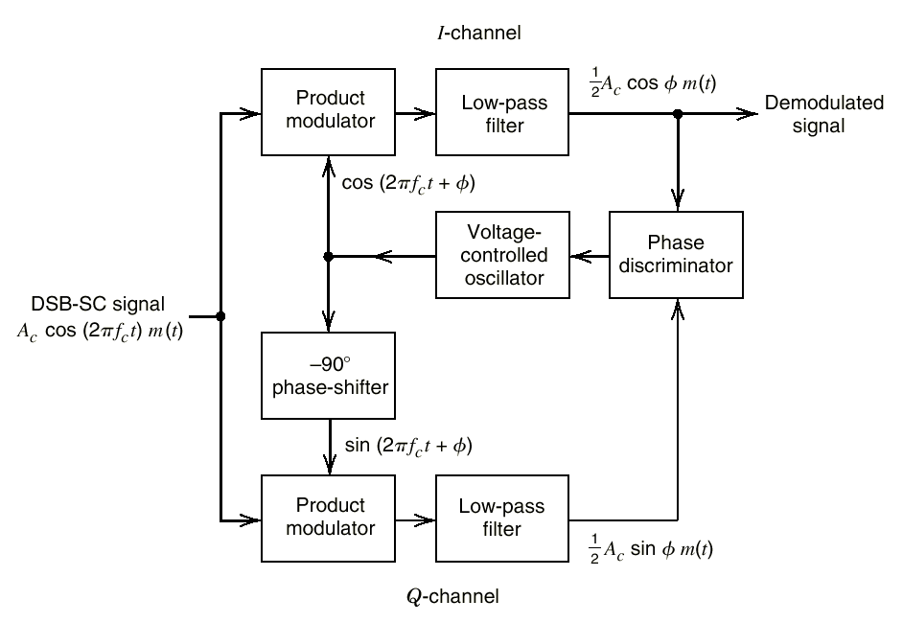
Classic coherent carrier extraction methods:
--Costas loop 科斯塔斯环法
VCO
鉴相器
complex
The phase discriminator output reflects the phase error. Via negative feedback, the loop adjusts the VCO to correct the local carrier phase, drives the phase difference to zero, and achieves carrier synchronization and signal demodulation.
鉴相输出电压反映相位误差，环路依靠负反馈调节 VCO，不断修正本地载波相位，使相位差趋近于 0，从而实现载波同步并完成信号解调。

Slide 8
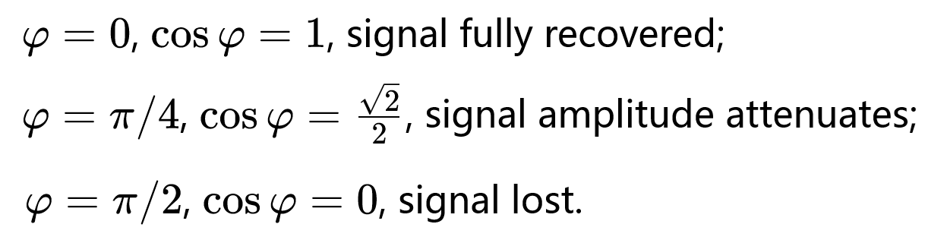

m(t)
sm(t)
BPF
带通滤波
LPF
低通滤波
~
Channel
×
m(t)
×
cosωct
cos(ωct+$φ\text{)}$
n(t)
加性噪声
Transmitter-receiver desynchronization
收发不同步
When the carrier phase changes dynamically (with frequency offset), the amplitude of the demodulated signal fluctuates periodically and causes signal distortion.
载波相位动态变化（存在频率差）时，解调信号幅度周期性起伏，产生信号失真。

Slide 9
DSB modulation system
Mathematical model: abstraction
数学模型：抽象
Time & frequency-domain characteristics
时域频域特性
Anti-noise performance 抗噪声性能
Practical AM system 实际 AM 系统
Special Topic: I/Q Paths I/Q支路专题

Slide 10
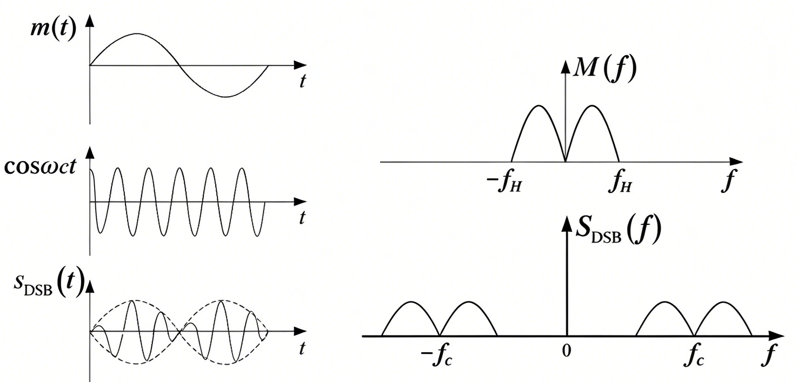
Time & frequency-domain characteristics
m(t)
sm(t)
BPF
带通滤波
LPF
低通滤波
~
Channel
×
m(t)
×
cosωct
carrier
cosωct
n(t)
加性噪声
？
？

Slide 11
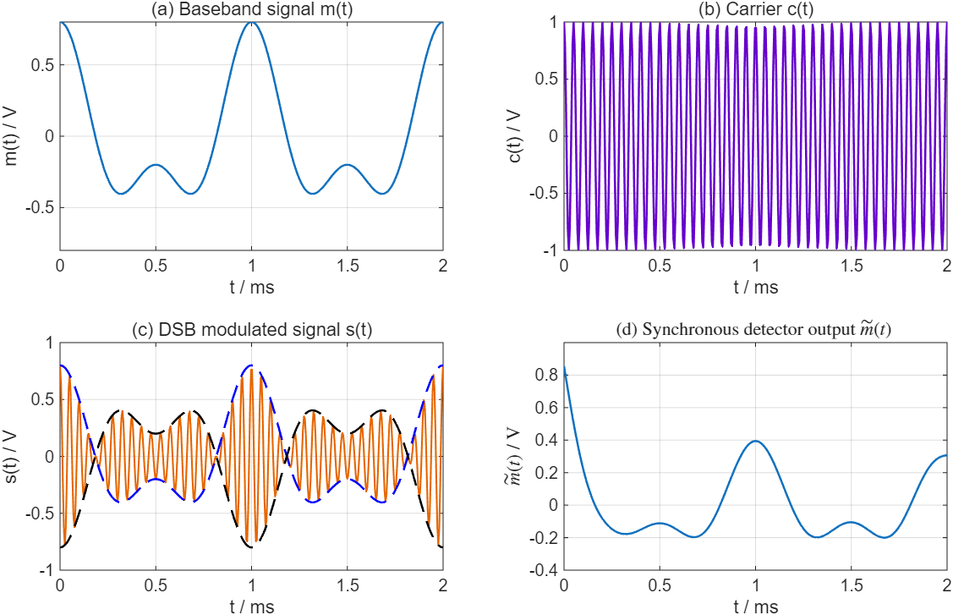
m(t)
sm(t)
BPF
带通滤波
LPF
低通滤波
~
Channel
×
m(t)
×
cosωct
carrier
cosωct
n(t)
加性噪声

Slide 12
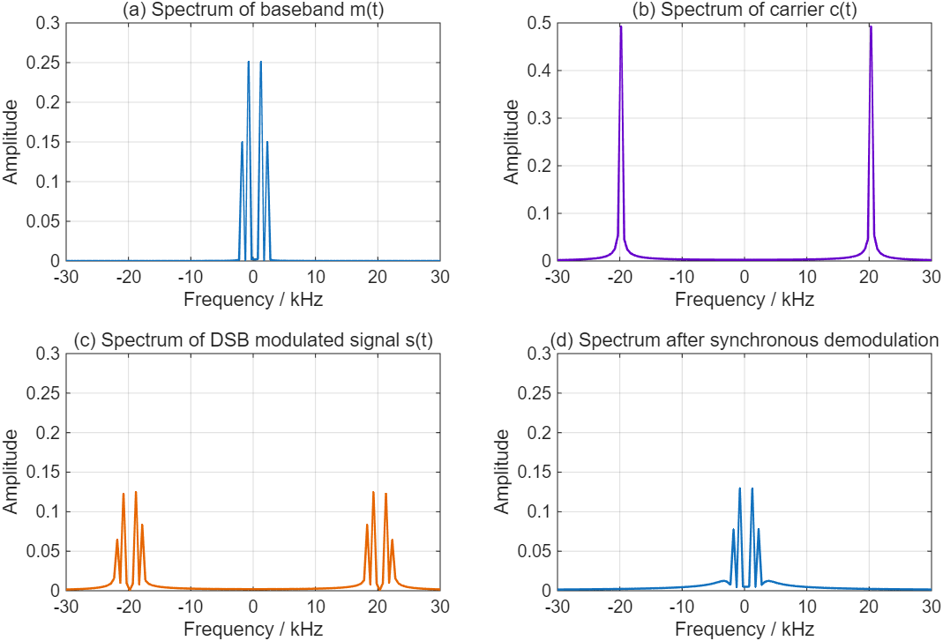
m(t)
sm(t)
BPF
带通滤波
LPF
低通滤波
~
Channel
×
m(t)
×
cosωct
carrier
cosωct
n(t)
加性噪声

Slide 13
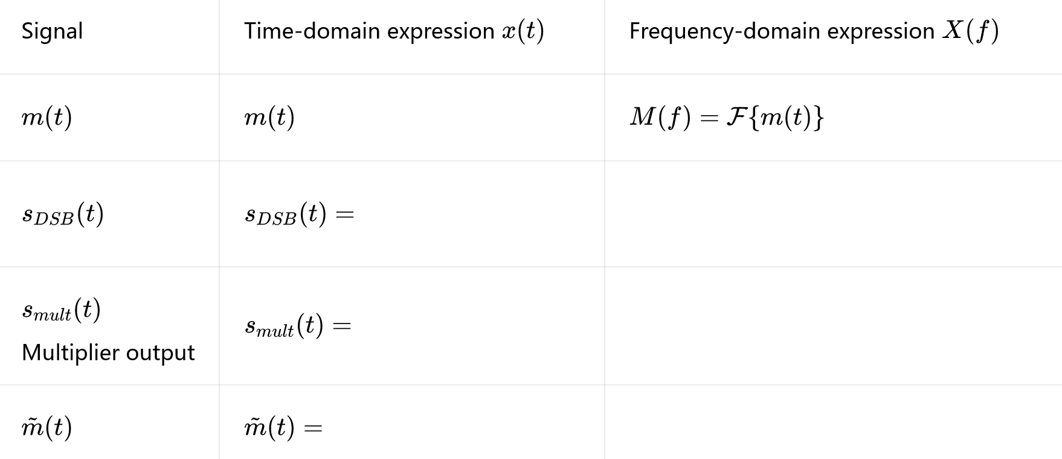
Time & frequency-domain characteristics
m(t)
sm(t)
BPF
带通滤波
LPF
低通滤波
~
Channel
×
m(t)
×
c
d
a
b
cosωct
carrier
cosωct
n(t)
加性噪声
d
a
b
c
d

Slide 14
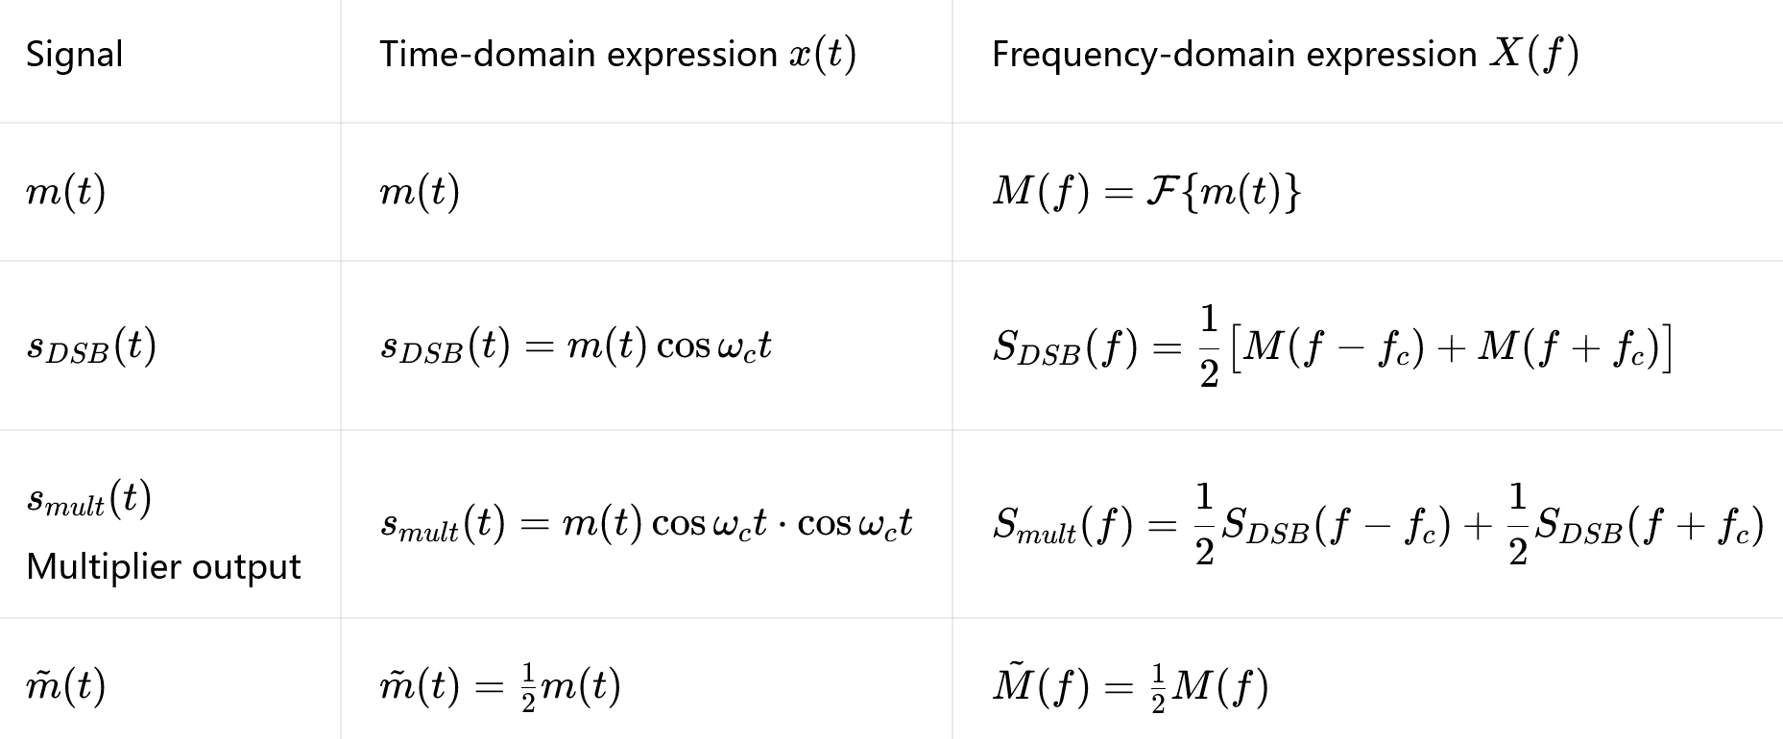
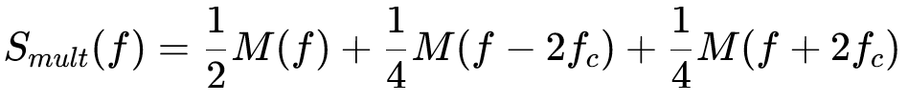
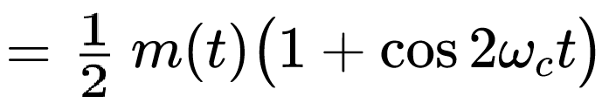
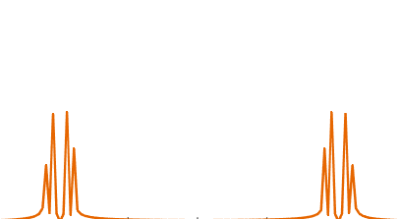
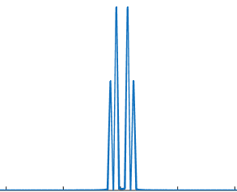
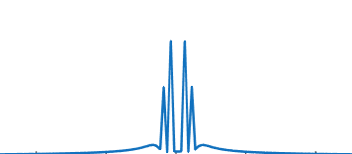
Comparison Table of Time-domain and Frequency-domain Expressions加频谱

Slide 15
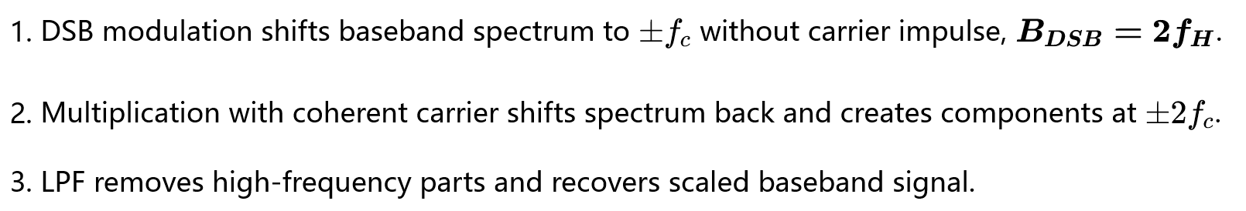
Comparison Table of Time-domain and Frequency-domain Expressions
1/2

Slide 16
DSB modulation system
Mathematical model: abstraction
Time & frequency-domain characteristics
Anti-noise performance 抗噪声性能
Practical DSB system
Special Topic: I/Q Paths I/Q支路专题

Slide 17
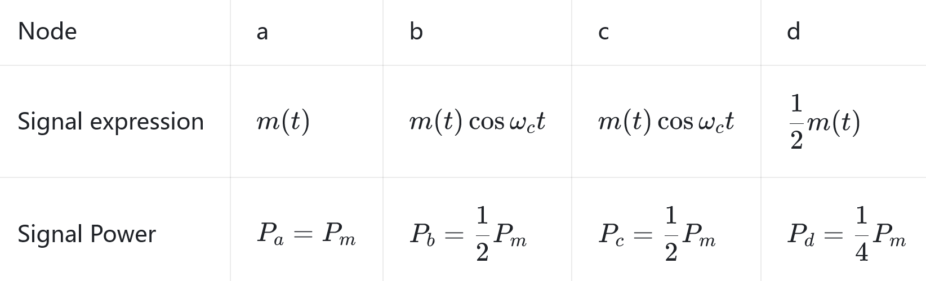
Anti-noise performance——Signal power
sm(t)
d
m(t)
BPF
带通滤波
LPF
低通滤波
~
Channel
×
m(t)
×
c
a
b
cosωct
carrier
n(t)
加性噪声
cosωct
Demodulator

Slide 18
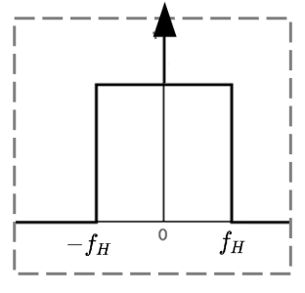



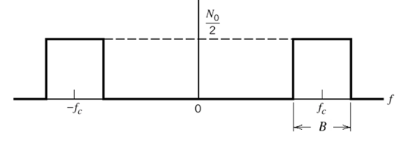




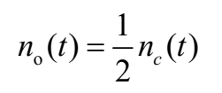
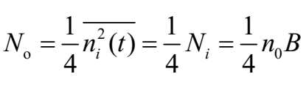
Anti-noise performance——Noise power
m(t)
sm(t)
BPF
带通滤波
LPF
低通滤波
~
Channel
×
m(t)
×
cosωct
carrier
n(t)
加性噪声
cosωct
Demodulator

Slide 19
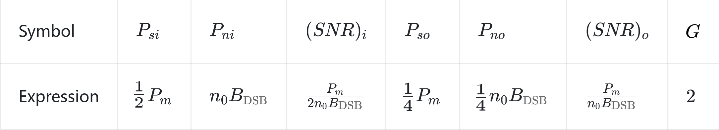
Anti-noise performance——G
m(t)
sm(t)
BPF
带通滤波
LPF
低通滤波
~
Channel
×
m(t)
×
cosωct
carrier
n(t)
加性噪声
cosωct
Demodulator
Conclusion：

Slide 20
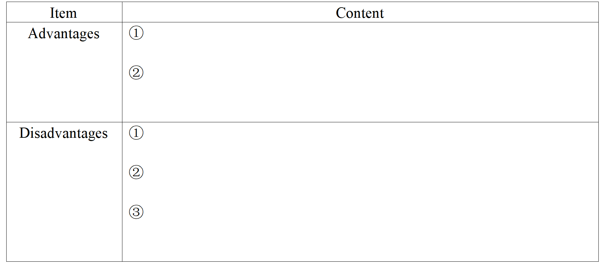
Discussion & Summary——DSB system

Slide 21
DSB modulation system
Mathematical model: abstraction
数学模型：抽象
Time & frequency-domain characteristics
时域频域特性
Anti-noise performance 抗噪声性能
Practical DSB modulation 实际 DSB调制
Special Topic: I/Q Paths I/Q支路专题

Slide 22
Practical DSB modulation 实际 DSB调制
FM Stereo MPX — A DSB-SC Subchannel
Composite baseband spectrum (schematic)
Optional RDS
centered at 57 kHz
19 kHz pilot
38 kHz carrier suppressed
S = L + R
(mono sum)
D = L − R DSB-SC
(suppressed carrier)
0
15
19
23
38
53
57
Frequency (kHz)
Band locations shown; heights are not signal levels.
MPX = sum signal + 19 kHz pilot tone + DSB‑SC
modulated difference signal
MPX = 和信号 (L+R) +19kHz 导频+DSB-SC 差信号 (L−R) +【可选 57kHz RDS】
In FM stereo broadcasting, MPX is the composite baseband signal. It is a baseband signal formed by superposing three signals and fed into the FM modulator.
在 FM 立体声广播里，MPX 就是复合基带信号（composite baseband），是把三路信号叠加在一起的基带信号，用来送入 FM 调制器：
备注： L = Left, left audio channel 左声道
R = Right, right audio channel 右声道

Slide 23
Practical DSB modulation 实际 DSB调制
FM Stereo MPX — A DSB-SC Subchannel
Band locations shown; heights are not signal levels.
Transmitter — parallel sum and difference paths
Matrix
encoder
S = L + R
D = L − R
S (L + R)
Σ
3 inputs
MPX
(composite baseband)
FM
modulator
(VHF broadcast band)
L
RF
to antenna
R
D (L − R)
Balanced multiplier
(mixer)
DSB-SC at 38 kHz
38 kHz
19 kHz pilot
MPX = sum + modulated difference + pilot
(optional RDS added separately)
Coherent 19/38 kHz generator
Receiver — MPX splits into three parallel paths
LPF 0–15 kHz
S (L + R)
Matrix decoder
L = (S + D) / 2
R = (S − D) / 2
FM
detector
L (left)
From
RF front end
MPX
BPF 23–53 kHz
×
LPF 0–15 kHz
/ gain
D (L − R)
R (right)
38 kHz reference
BPF at 19 kHz
PLL + coherent ×2
Match the sum and difference path gains and delays.
DSB-SC is hardly used independently for wireless voice broadcasting; it mostly serves as an internal sub-modulation module in communication systems. DSB-SC 几乎不单独直接用作无线语音广播，大多作为系统内部子调制模块。

Slide 24
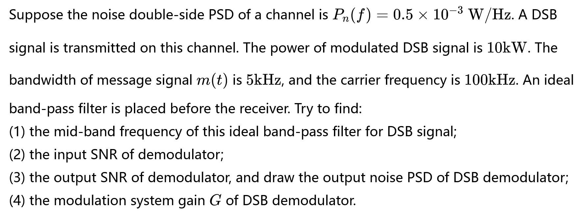
Example
(SNR)o通过计算得到，不用G=2的结论

Slide 26
DSB modulation system
System model: abstraction
系统模型：抽象
Time & frequency-domain characteristics
时域频域特性
Anti-noise performance 抗噪声性能
Practical DSB modulation 实际 DSB调制
Special Topic: I/Q Paths I/Q支路专题

Slide 27
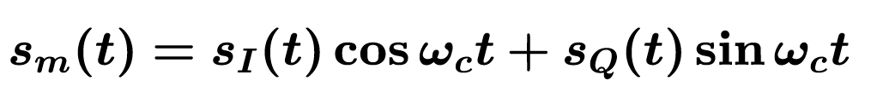
I、Q 支路专题——Modulation

Slide 28
I、Q 支路专题——VIP
Convert complex RF problems to baseband signal processing
将复杂射频问题转化为基带信号处理问题(最核心的价值)。
RF signals have high frequencies. Sophisticated filtering and phase shifting are hard to implement directly in the RF domain:
射频频率很高，直接在射频域做复杂滤波、移相非常困难。

Slide 29
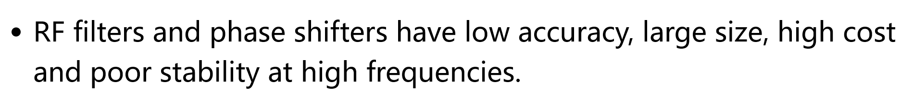
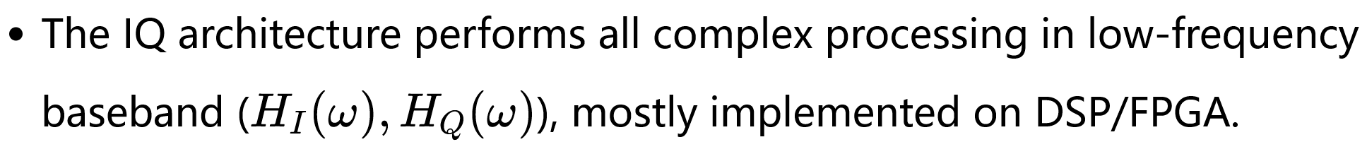
射频滤波器、移相器在高频条件下精度差、体积大、成本高且稳定性差；
IQ 架构将全部复杂信号处理放在低频基带完成，大多由 DSP/FPGA 实现。
After baseband processing, a single up-conversion (I/Q multiplied by carriers and summed) shifts the signal to RF.
基带处理完成后，仅通过一次上变频（I/Q 乘以载波后相加），把信号搬移至射频。

Slide 30
I、Q 支路专题——Demodulation
~
I path
LPF
低通滤波
sI(t)
×
2cosωct
sm(t)
-90°
Phase-shifter
2sinωct
~
sQ(t)
Q支路
×
LPF
低通滤波
This IQ quadrature demodulator splits the received signal into two paths, multiplies by orthogonal local carriers and applies low‑pass filtering to recover I/Q baseband signals.该 IQ 正交解调器将接收信号分为两路，与正交本地载波相乘并进行低通滤波，恢复 I/Q 基带信号。

Slide 31
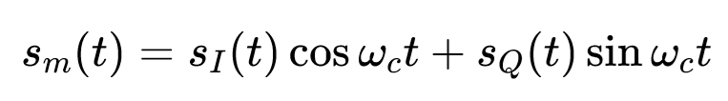
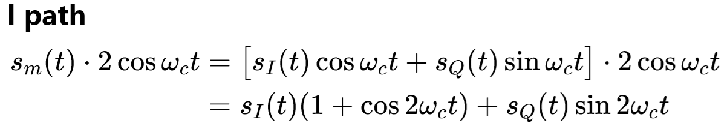

I、Q 支路专题——Demodulation
~
I path
LPF
低通滤波
sI(t)
×
2cosωct
sm(t)
-90°
Phase-shifter
2sinωct
~
sQ(t)
Q支路
×
LPF
低通滤波
LPF output :

Slide 32
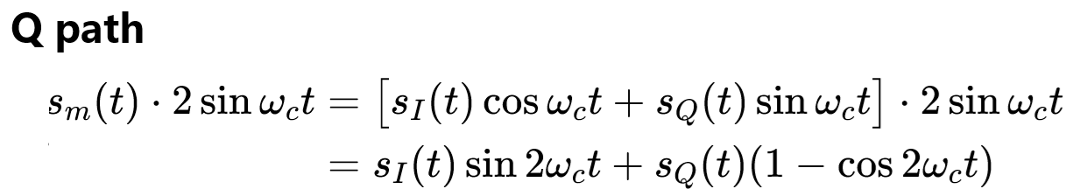

I、Q 支路专题——Demodulation
~
I path
LPF
低通滤波
sI(t)
×
2cosωct
sm(t)
-90°
Phase-shifter
2sinωct
~
sQ(t)
Q支路
×
LPF
低通滤波
LPF output :

Slide 33
I、Q 支路专题——Demodulation
~
I path
LPF
低通滤波
sI(t)
×
2cosωct
sm(t)
-90°
Phase-shifter
2sinωct
~
sQ(t)
Q支路
×
LPF
低通滤波
The carriers at the transmitter and receiver must be synchronized in frequency and phase; otherwise, demodulation distortion will occur.
收发端载波必须保持频率、相位同步，否则会产生解调失真。

Slide 34
?
Complete transmit-receive model
完整的收发模型

Slide 35


Slide 36


